Slide 1
City of Dania Beach
Commission Meeting
March 10, 2015

Slide 2
Overview of Planning and Development in Broward County

Slide 3
The County’s Role in Planning
Late 1970’s and Early 1980’s
Broward County Charter
Broward County Land Use Plan
Broward County Comprehensive Plan

Slide 4
Broward County Charter
Since the 1970’s, Broward County has a countywide role in land use planning.
BCLUP
Lower density
Auto-oriented design
Suburban

Slide 5
Development Over Time

Slide 6
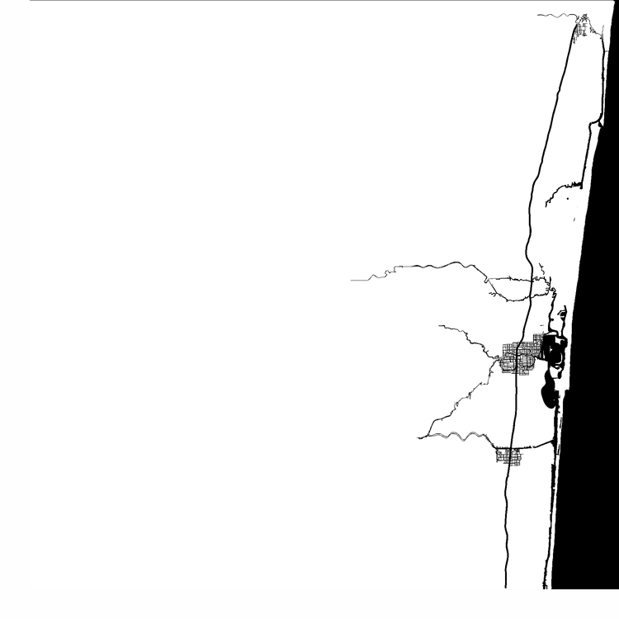
1915

Slide 7
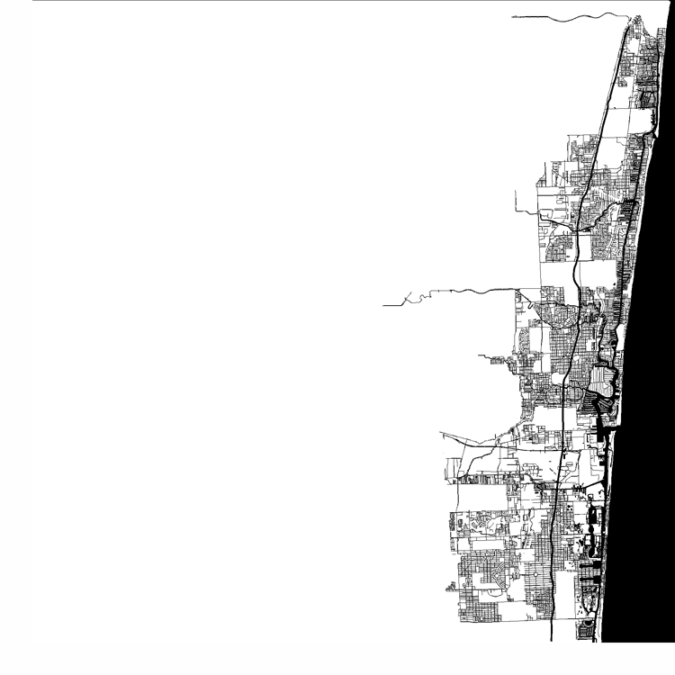
1924

Slide 8
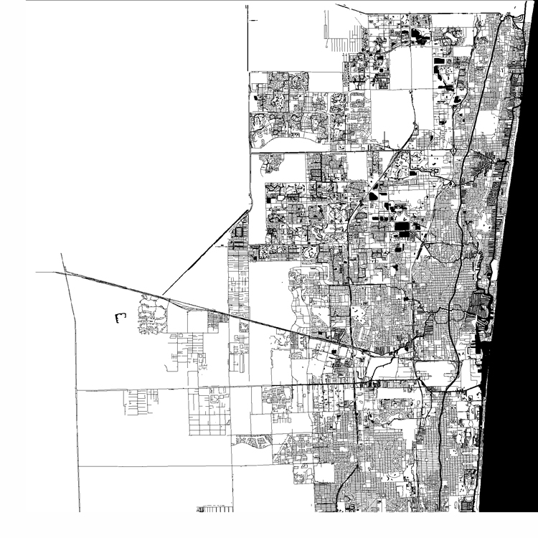
1980
Population ▪ 1,018,200

Slide 9
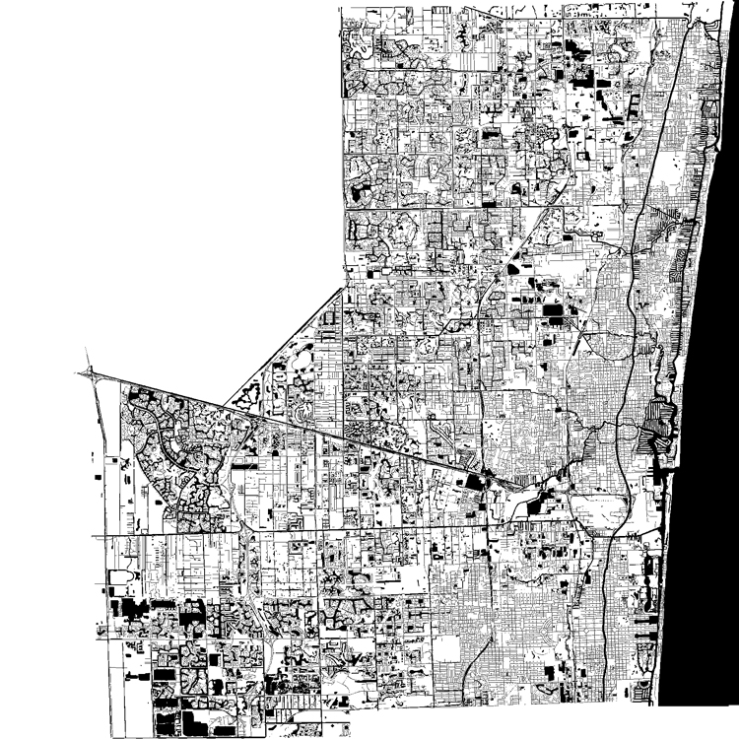
2014
Population ▪ 1,771,099

Slide 10
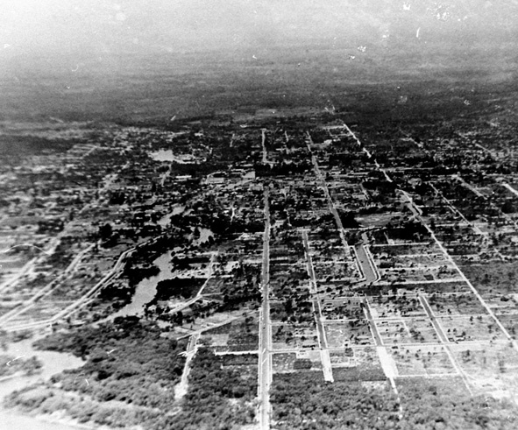
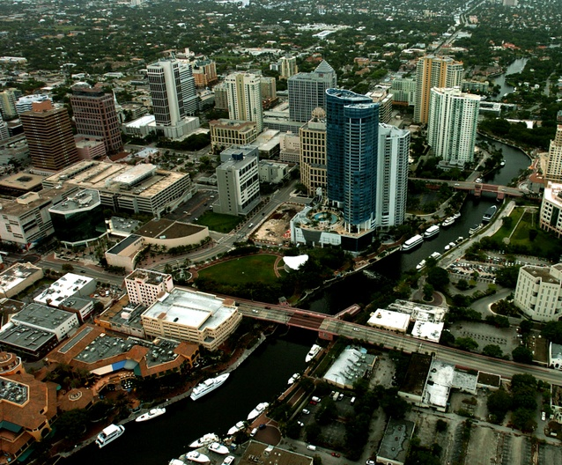
Downtown Fort Lauderdale
1920s
2000s
Credit this photo:
State Archives of Florida, Florida Memory, http://floridamemory.com/items/show/28584 & sunny.org

Slide 11
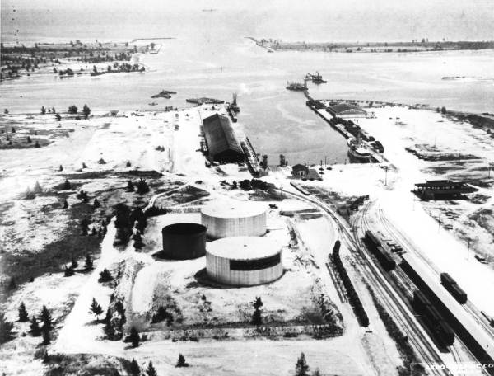
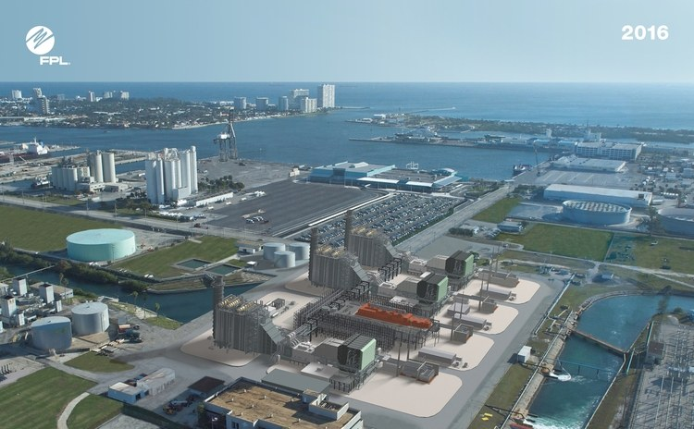
Port Everglades
1930s
2016
Credit this photo:
State Archives of Florida, Florida Memory, http://floridamemory.com/items/show/1188 & FPL

Slide 12
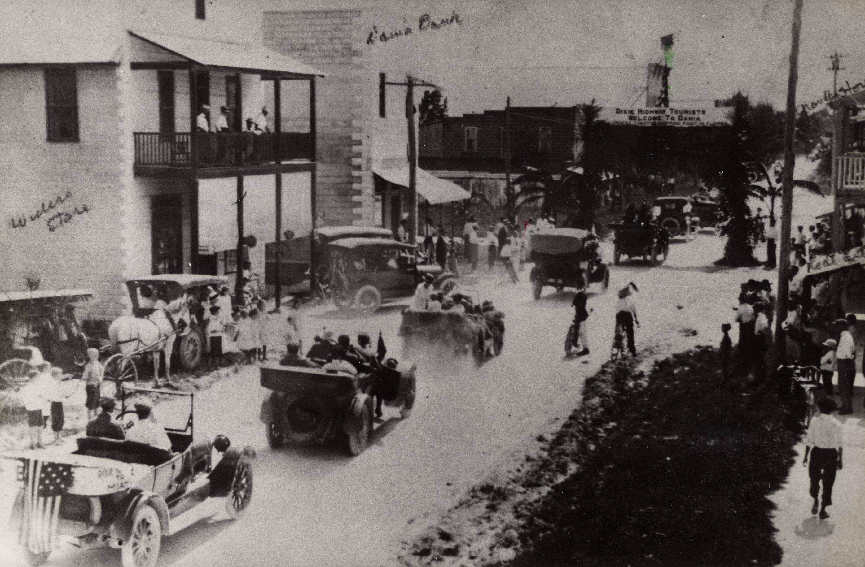
City of Dania Beach – Dixie Highway

Slide 13
Issues in the 21st Century: Disconnect with the 1970’s “vision”

Slide 14
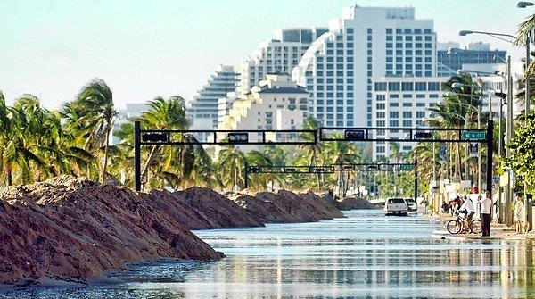
Climate Change

Slide 15
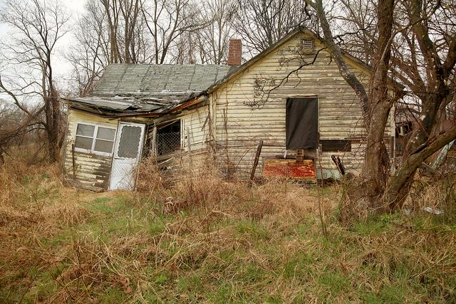
Affordable Housing
October 2006 ▪ FOR SALE: ONLY $500,000!
NOT WATERFRONT

Slide 16
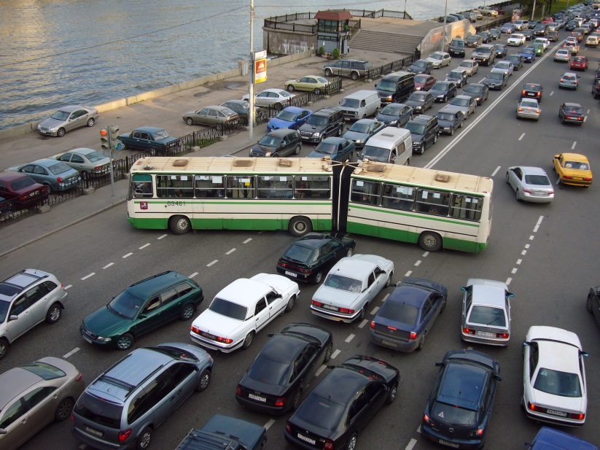
Complete Streets and Transit

Slide 17
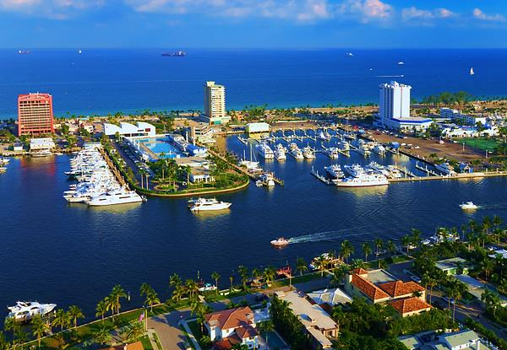
Barrier Island

Slide 18
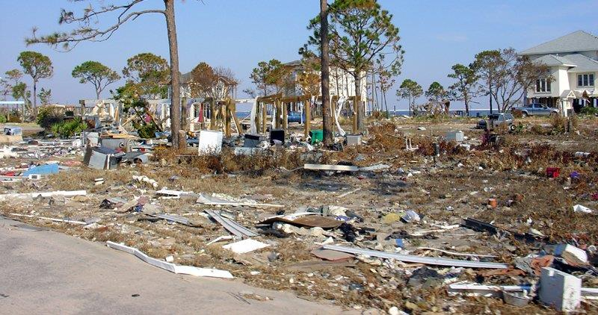
Post Disaster

Slide 19
Intergovernmental Relations

Slide 20
We are at a crossroads

Slide 21
Future Growth
By 2040, Broward will have
250,000
new residents.

Slide 22
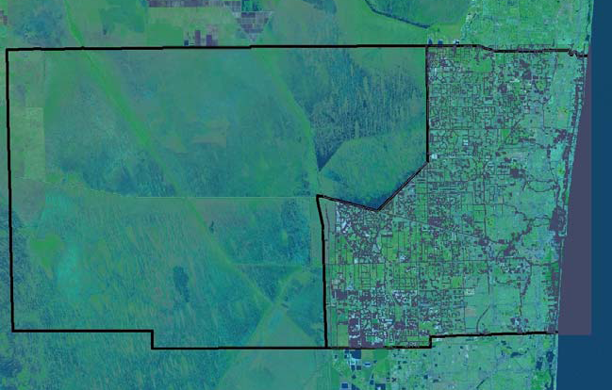
Today
With the undevelopable Everglades to the west and Atlantic Ocean to the east, Broward County is almost built out.

Slide 23
Ad Hoc Steering Committee
Intergovernmental Coordination / Statutory Requirements
Redevelopment
Housing
Natural, Recreational, and Historic Resources
Transportation
Public Facilities – Non Transportation
Disaster Prevention and Emergency Management

Slide 24
Initial Feedback Highlights
● Streamline County Land Use Plan amendment process
● Develop thresholds to require County Land Use Plan amendment process for only proposed development that is regional in scope or significantly impacts adjacent municipalities.
● Allow property development rights to be transferred to other property (“Transfer of Development Rights”).
● Re-evaluate and promote walkable and transit- oriented mixed-use land uses

Slide 25
Initial Feedback Highlights
● Target new development toward downtowns and major transit/rail corridors/stations.
● Revisit the County’s existing general limit of 50 housing units per acre
● Enact a multi-modal level of service/impact analysis for land use plan amendment review
● Prioritize and strengthen “Complete Streets” policies countywide.
● Address the anticipated effects on public infrastructure resulting from climate change, including sea level rise.

Slide 26
Survey Results - Summary
● Transportation is the number one planning priority
● Climate Change/Sea Level Rise was a high priority across the focus areas
● Make the BCLUP text and map more user friendly
● Reconsideration of density limitations

Slide 27
➲ FRAMEWORK FOR NEXT STEPS
SECTION 1
Highlighted Regional Issues and Strategies  Multi-Modal Transportation Options  Affordable Housing  Climate Change Resiliency  State of the Art Environmental Protection  Targeted Redevelopment  Renewed Partnership - Intergovernmental Coordination

Slide 28
➲ FRAMEWORK FOR NEXT STEPS
SECTION 2
General Land Use Plan Requirements: Implementation Policies, Programs, & Incentives  Enabling Legislation for Countywide Programs  State/Statutory Requirements  Implementation Requirements  Incentive Programs  Land Use Plan Map Series
SECTION 3
Land Use Plan Recommended Best Practices

Slide 29
Timeline
Ad Hoc and Focus Groups Meetings/Outreach/Final Recommendations
2014-2016

Slide 30
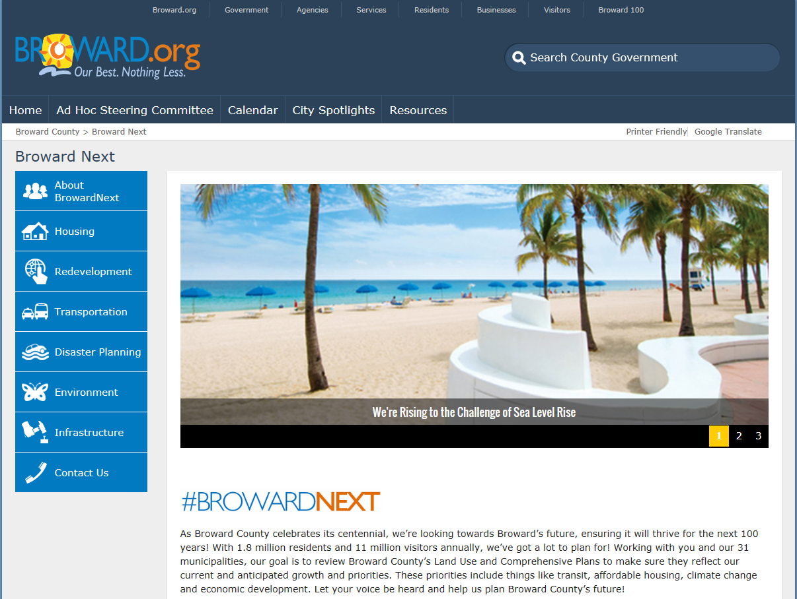
Join the Conversation!
www.browardnext.org

Slide 31
Thank You!
Q&A

